Slide 1
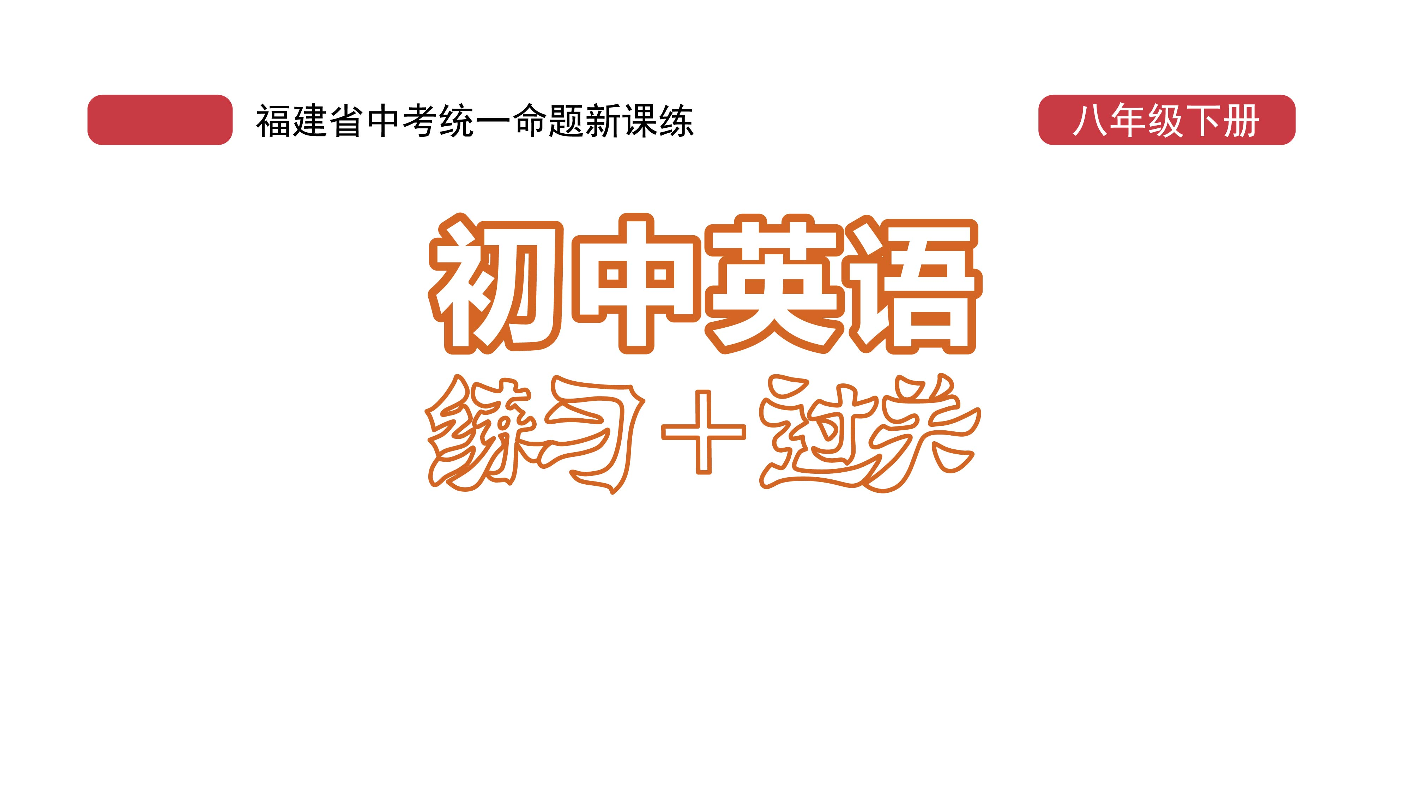
课时练习
模块五 第一章 读写综合训练

Slide 2
一、完形填空。
Kelly can hardly believe that she was so stupid! At lunchtime in a busy sandwich bar, she hung(挂) her 1 on the back of her chair. Seconds 2 , the bag was gone and her mobile phone, her money, her bank cards and her keys were all gone with it. 3 .she was with her friend, Anna. Using Anna’s
1. A. coat B. bag C. umbrella
2. A. later B. before C. after
3. A. Clearly B. Suddenly C. Luckily
B
A
C

Slide 3
一、完形填空。
phone, Kelly was able to call the bank and the phone company(公司) 4 . The thief(小偷) would not be able to use her cards or her phone, at least!
Back at the office, Kelly began to feel better. Her workmates asked if 5 could lend her some money. She felt so warm. But one more difficulty was
4. A. at once B. for a while C. in the end
5. A. we B. you C. they
A
C

Slide 4
一、完形填空。
ahead. Kelly’s bike was locked(锁上). Unless she could unlock it, she would not be able to get home that night. She asked Tom, the Building Manager, if he could 6 . He tried very hard, but he couldn’t cut or 7 the lock.
6. A. help B. invite C. appear
7. A. decide B. break C. change
A
B

Slide 5
一、完形填空。
Kelly rang the fire brigade(消防队) and explained the situation. Four 8 later, a red fire-engine pulled up outside the building. “We always travel like this,” one of the 9 joked(开玩笑说), as the others took down the cutting equipment(设备) and freed Kelly’s bike.
8. A. weeks B. days C. minutes
9. A. firemen B. policemen C. postmen
C
A

Slide 6
一、完形填空。
B
As she 10 her bike home, Kelly thought, “For every one thief in London, there are thousands of ordinary kind people!”
10. A. made B. rode C. carried

Slide 7
二、阅读理解。
Johnny, a 15-year-old student, is checking his dad’s old jacket. He says, “You’re 45, Dad. You’re never going to wear this again. Can I have it?”
Johnny’s father, Keith, has had a bad day at work, and he is feeling old. And Johnny has hit his pain(痛处). Keith raises his voice and says, “What? You mean I’m too old to wear the jacket again?”

Slide 8
二、阅读理解。
Johnny feels like this came out of nowhere, and now he feels hurt. “But I only asked. Why are you shouting at me?” “But I don’t like being treated as though I’m too old.” Both of them feel a bit upset.
Have you ever had a similar argument(争吵) with the people around you? Here are some tips for you to remember when you’re getting mad.

Slide 9
二、阅读理解。
● Accept your feelings and think about the other person’s feelings. That means not always making yourself “right” or “clever” and the other person “wrong” or “stupid”.
● Speak out your ideas by starting with “I …” but not “You …”.

Slide 10
二、阅读理解。
● Don’t decide the purpose(意图) of the other person by your guessing. Try to work out what he or she is feeling, and admit(承认) it if you were wrong.
Don’t forget that it’s never too late to start learning the ways of communicating(沟通).

Slide 11
二、阅读理解。
( )1. From the passage, we know Johnny _______.
A. is a school boy
B. doesn’t like his dad
C. thinks his dad is too old
D. wants his dad’s new jacket
A

Slide 12
二、阅读理解。
( )2. Johnny felt hurt because his dad _______.
A. hit his pain B. had a busy day
C. liked the jacket D. was angry with him
D

Slide 13
二、阅读理解。
( )3. To avoid(避免) an argument, the writer gives us ________ suggestions.
A. 2 B. 3 C. 4 D. 5
B

Slide 14
二、阅读理解。
( )4. According to the passage, if you want to express(表达) your ideas, you’d better begin like this: “________”.
A. You misunderstood me …
B. I know how you feel, but …
C. They’re different from us …
D. Things aren’t the same …
B

Slide 15
二、阅读理解。
( )5. The best title for the passage can be _______.
A. Learn to admit your mistakes(错误) bravely
B. Be patient(耐心的) with the people around you
C. An argument between a father and a son
D. Good communication is important
D

Slide 16
三、短文填空。
My grandpa loves playing chess(象棋). Every day he plays chess with his friends. Last week, he came to visit us in Canada. But he was very 1 ./ˌdɪsə'pɔɪntɪd/ when he found nobody here could play chess with him.
One day, when I came back from school, I found my grandpa was 2 (sit) quietly in a chair, doing nothing. .
disappointed
sitting

Slide 17
三、短文填空。
lonely
I knew he was 3 /'ləʊnli/. “Why not teach him to play online chess on my computer?” I thought.
“Grandpa, someone is waiting for you to play chess,” I went to him and said.
“Really?” he said, with his eyes opening 4 . /waɪd/. “Who? And where?”
I took him to 5 computer in my room and said, “Right here.” Then I taught him how to use the
wide
the

Slide 18
三、短文填空。
first
Internet and how to play chess online. At 6 . (one), he was slow. Having tried several times, he became better and began to play chess with people from around the world.
“How 7 (interest) it is! This is simply fantastic!” he cried excitedly.
interesting

Slide 19
三、短文填空。
at
Now he is quite good 8 playing chess online and has made a lot of friends on the Internet at the same time. My grandfather is much 9 . (happy) than before.
Grandpa will go back home soon. I believe the time when we played online chess together was so great 10 both of us will never forget.
happier
that

Slide 20
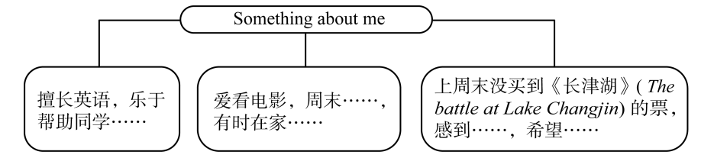
四、书面表达。
假如你叫Jim, 请根据以下思维导图的提示，用英语写一篇70词左右的小短文介绍自己。

Slide 21
四、书面表达。
Something about me
My name is Jim. I’m good at English. And I’m always glad to help my classmates with their English. I enjoy watching movies. On weekends, I often go to the movies with my friends. Sometimes, I just watch English movies on the Internet at home.

Slide 22
四、书面表达。
Last weekend, I wanted to see the movie The battle at Lake Changjin, but I wasn’t able to get a ticket. I felt a little disappointed. I hope I can get a ticket to the movie this weekend.

Slide 23
